Slide 1


Slide 2
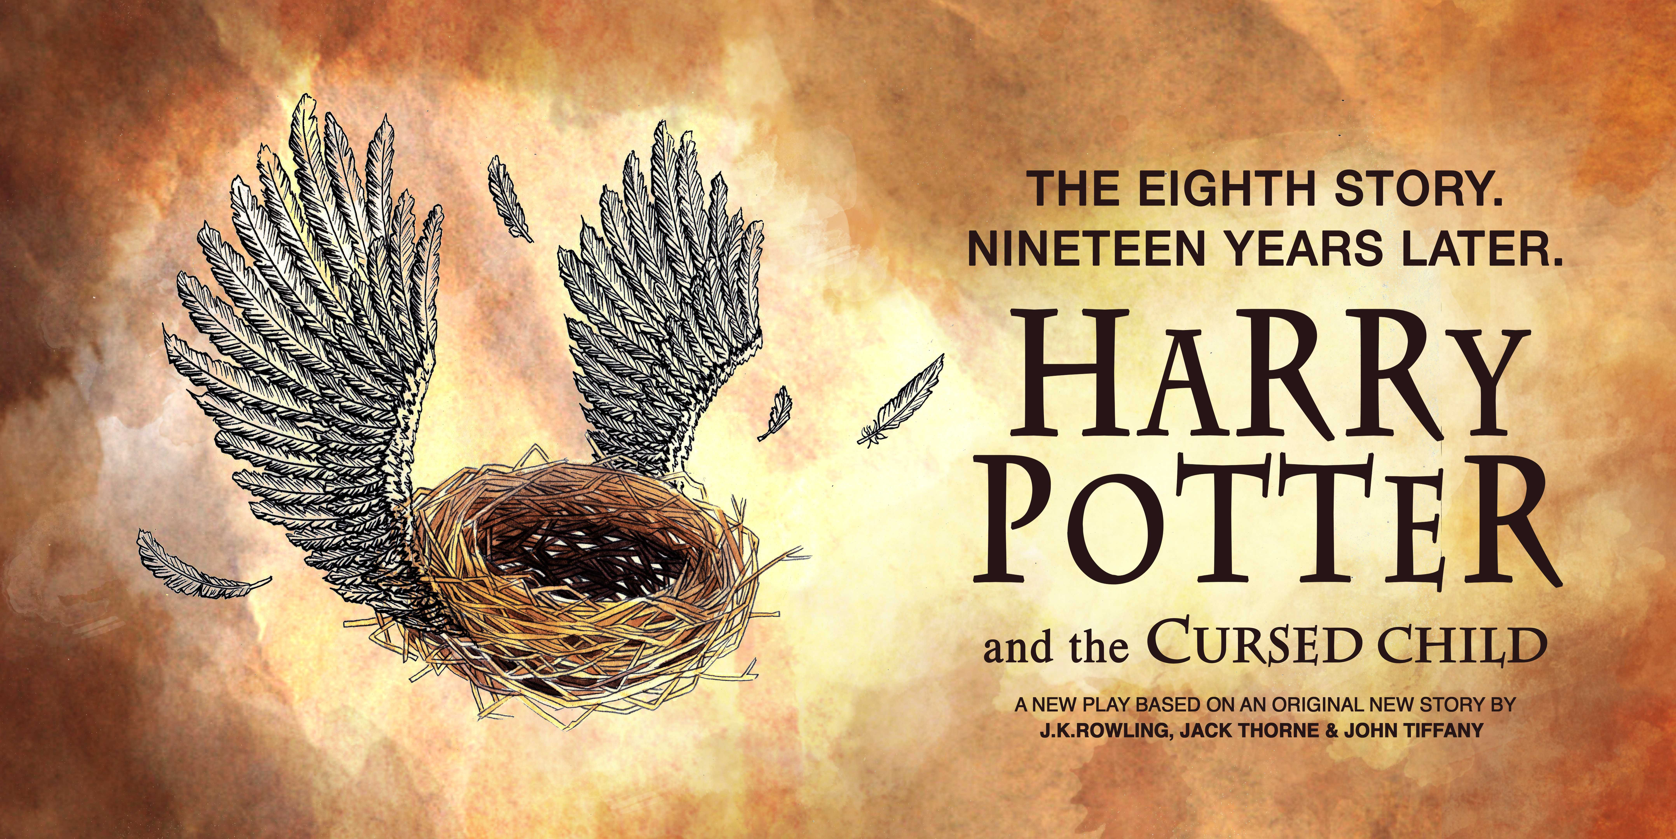

Slide 3

The book begins at King's Cross Station, with Harry's and Hermione’s respective children—Albus Potter and Rose Granger-Weasley—going off to Hogwarts for the first time. Albus is afraid that he will break the family tradition and be sorted into Slytherin rather than Gryffindor. On the Hogwarts Express, Albus makes friends with Scorpius Malfoy, the son of Draco Malfoy. Scorpius is sorted into Slytherin, then in a complete surprise Albus Potter is sorted into Slytherin. Rose is sorted into Gryffindor and becomes popular as Albus shows no particular magical aptitude, thus widening the distance between her and her cousin Albus. Scorpius and Albus are friends, but rumors about Scorpius's birth cause him to be an outcast.
Draco Malfoy is tormented by rumors that Voldemort used a Time-Turner to impregnate his wife Astoria to give birth to Scorpius. He asks Harry Potter for a statement that all Time-Turners have all been destroyed. Harry is then visited by Amos Diggory and his niece Delphi, who each want Harry to go back in time to the Triwizard tournament and save his son, Cedric, since he was an innocent victim of Lord Voldemort.
Over a holiday, Harry arrives to give Albus a present: his own baby blanket. The gesture feels empty; Albus and Harry argue about Albus’s difficulties at school and Harry says he sometimes wishes Albus wasn’t his son. Albus leaves to go back to Hogwarts and Harry’s scar begins to hurt for the first time in nineteen years.
Albus and Scorpius offer to help Amos and Delphi Diggory by using the Time-Turner to go back in time to stop Cedric’s death by saving him from winning the Triwizard Tournament. They use Polyjuice Potion to steal a Time-Turner from the Ministry of Magic and defeat Cedric in the first round of the Tri-wizard tournament.

Slide 4
Harry and Draco discover Albus and Scorpius outside Hogwarts when they are transported back to the present, as the Time-Turner has a five-minute limit. After being warned of a "dark cloud" around his son by the centaur Bane, Harry tells Albus to keep away from Scorpius.
The next day, the meddling with time yields small changes. Ron is married to Padma Patil, Hermione is a teacher at Hogwarts, and Albus is now in Gryffindor. They go back in time to defeat Cedric’s Second Task of the tournament. When they return to the future, Scorpius can’t find Albus and is informed by Headmistress Umbridge that Harry Potter was killed during a failed coup on the school at the Battle of Hogwarts; Albus does not exits. Scorpius goes to Severus Snape, who in this narrative is still alive, to ask for help. Scorpius explains that Harry Potter is alive and Voldemort is dead in another world. Snape leads them to the base of the resistance, The Order of the Phoenix. They use the Time-Turner to go back to the Triwizard tournament and Albus is prevented from casting his spell on Cedric. When they return, Dementors arrive and suck out Hermione and Ron’s souls. Snape is also killed.
Scorpius goes back in time and finds Albus alive. Scorpius wants to destroy the Time-Turner. They hand it to Delphi but realize she is not a Diggory; she is the daughter of Lord Voldemort. Delphi wants Albus to travel in time to make Voldemort ruler by humiliating Cedric or she will kill Scorpius. She takes them back in time to the Third Task maze and tortures Scorpius, but is struck by Cedric who thinks it is part of the tournament. Delphi, Albus, and Scorpius pick up the time-turner and Delphi destroys it.

Slide 5
They stop at an unknown period. Albus and Scorpius discover that they have been transported to the day that Harry’s parents died. Delphi aims to stop Voldemort from attempting to kill Harry in the first place, so that when he kills Harry, the curse will not be rebounded.
Albus and Scorpius send a message to Harry in the present through the baby blanket that Harry gave to Albus with the date and time they are at. Draco has indeed concealed a Time-Turner, and Harry, Ginny, Draco, Ron, and Hermione travel in time to the date: Halloween Eve, 1981. When they arrive Harry transforms into Voldemort to distract Delphi. Delphi explains to him that she is the child of an affair between Voldemort and Bellatrix Lestrange. The transfiguration begins to fade and Delphi realizes it's Harry, not Voldemort. They duel, and Albus helps his father to beat Delphi. They then hear the real Voldemort arriving to kill Harry’s parents and realize they cannot intervene or risk changing the future. Harry watches his parents being murdered.
In the present, Scorpius asks out Rose Granger-Weasley who declines, but give him hope for the future. Harry pledges to be a better father and explains that Dumbledore and Snape were great, but flawed men, and he must not feel obligated to live up to their accomplishments. Both Harry and Albus are filled with hope for their relationship.

Slide 6
